Slide 1
Bitcoin Price Prediction with Logistic Regression, LDA & Random Forest
May 10
Renjie Qian

Slide 2
Paper List
J. Amjad, M., Shah, D. (2016), Trading Bitcoin and Online Time Series Prediction, in NIPS Time Series Workshop 2016, Barcelona, Spain.

Slide 3
Content
Feature engineering discarding order book
Truncated prediction model
ARIMA
Logistic regression, LDA & Random Forest
Empirical conditional

Slide 4
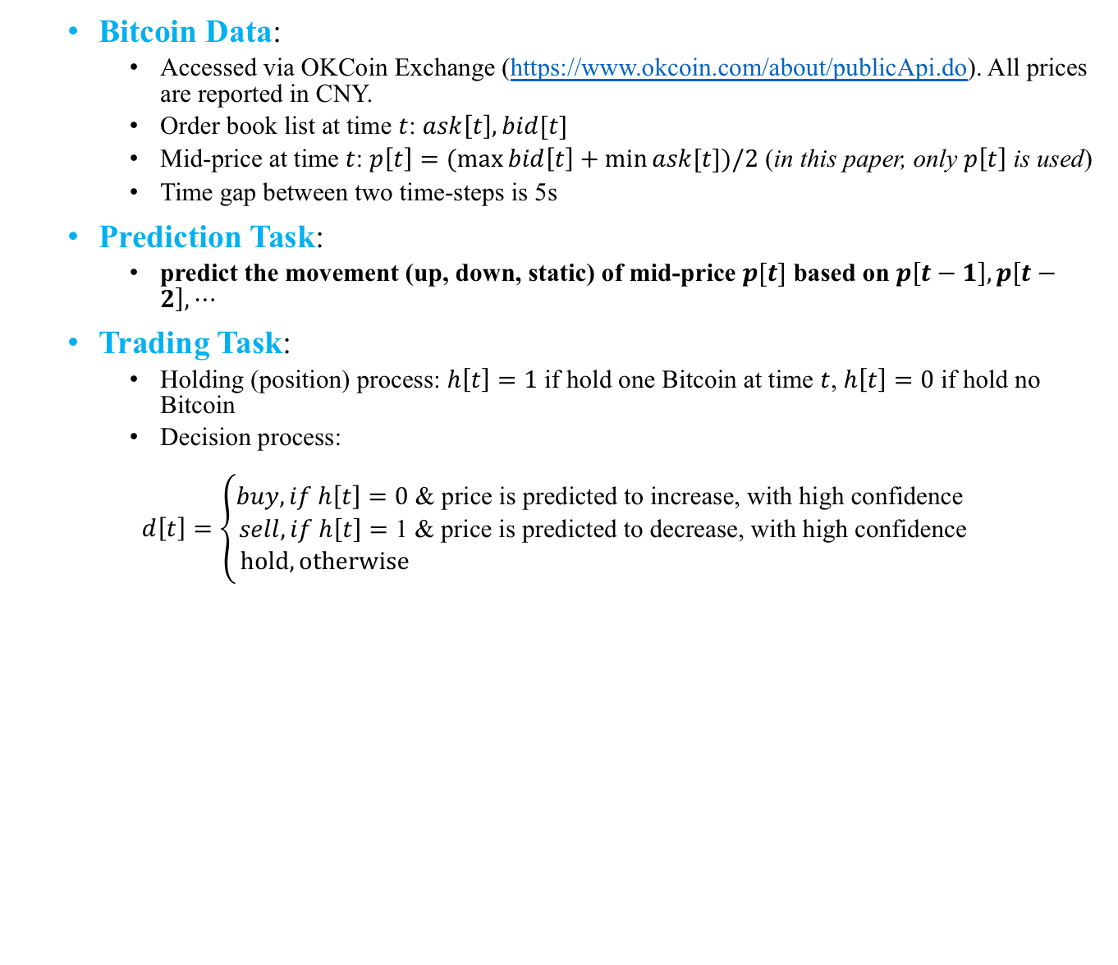
Bitcoin Data & Target
Bitcoin Data:
Accessed via OKCoin Exchange (https://www.okcoin.com/about/publicApi.do). All prices are reported in CNY.
Order book list at time $t$: $ask\left[t\right], bid[t]$
Mid-price at time $t$: $p\left[t\right]=(\max{bid\left[t\right]}+\min{ask[t]})/2$ (in this paper, only $p\left[t\right]$ is used)
Time gap between two time-steps is 5s
Prediction Task:
predict the movement (up, down, static) of mid-price $p[t]$ based on $p\left[t−1\right], p\left[t−2\right], ⋯$
Trading Task:
Holding (position) process: $h\left[t\right]=1$ if hold one Bitcoin at time $t$, $h\left[t\right]=0$ if hold no Bitcoin
Decision process:
$$d\left[t\right]=\left\{\begin{aligned}buy, if h\left[t\right]=0\text{ & }\text{price} \text{is} \text{predicted} \text{to} \text{increase}\text{, }\text{with} \text{high} \text{confidence} \\ sell, if h\left[t\right]=\text{1 & }\text{price} \text{is} \text{predicted} \text{to} \text{decrease}\text{, }\text{with} \text{high} \text{confidence} \\ hold, otherwise \end{aligned}\right.$$

Slide 5
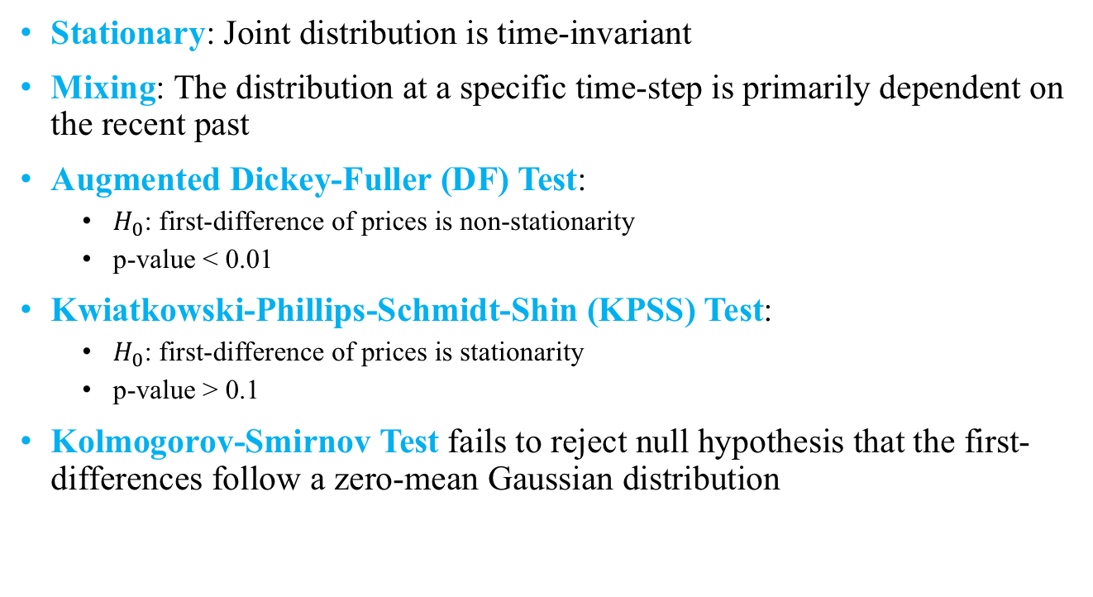
Stationary, Mixing Assumption and Corresponding Test
Stationary: Joint distribution is time-invariant
Mixing: The distribution at a specific time-step is primarily dependent on the recent past
Augmented Dickey-Fuller (DF) Test:
$H_{0}$: first-difference of prices is non-stationarity
p-value < 0.01
Kwiatkowski-Phillips-Schmidt-Shin (KPSS) Test:
$H_{0}$: first-difference of prices is stationarity
p-value > 0.1
Kolmogorov-Smirnov Test fails to reject null hypothesis that the first-differences follow a zero-mean Gaussian distribution

Slide 6
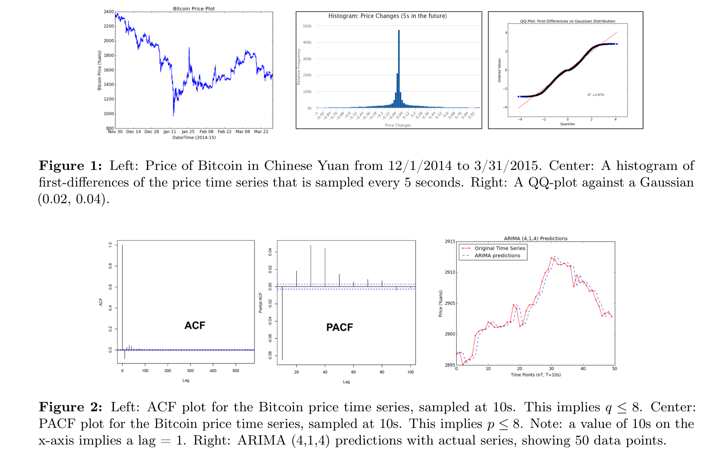

Slide 7
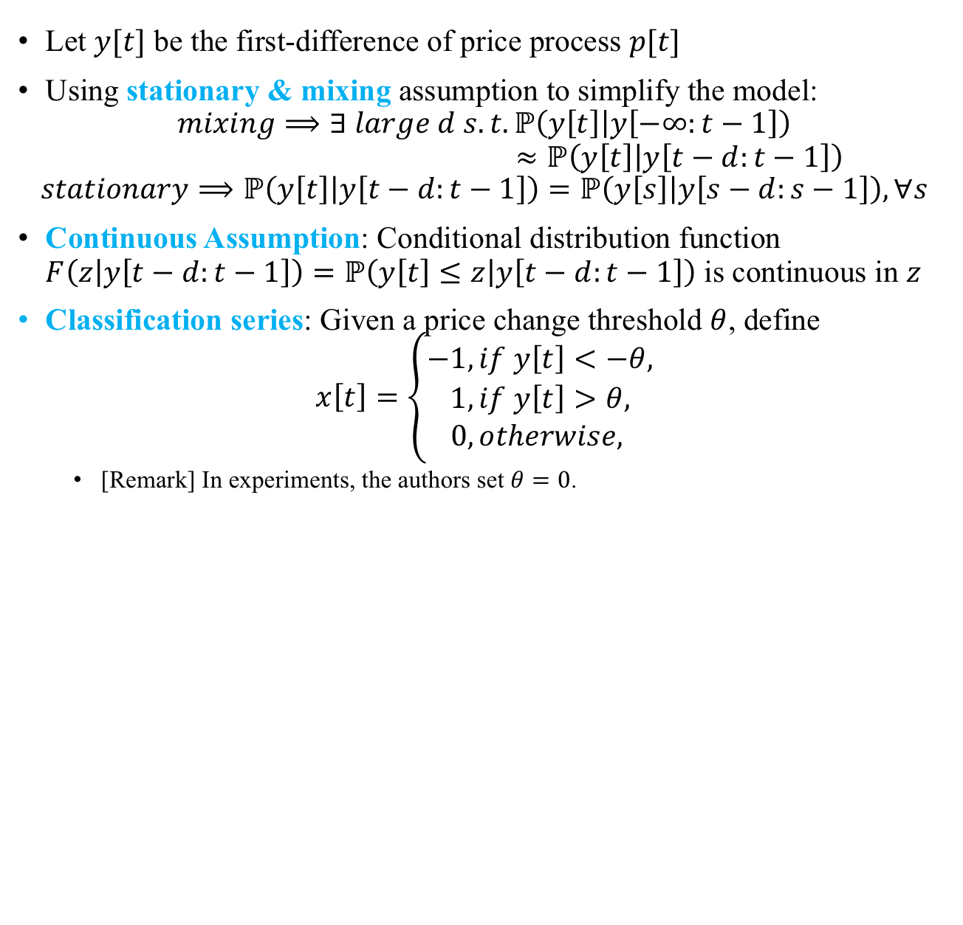
Prediction Model
Let $y[t]$ be the first-difference of price process $p[t]$
Using stationary & mixing assumption to simplify the model:
$$mixing⟹∃ large d s. t. ℙ\left(y\left[t\right] | y\left[−∞:t−1\right]\right)$$
$$≈ℙ\left(y\left[t\right] | y\left[t−d:t−1\right]\right)$$
$$stationary⟹ℙ\left(y\left[t\right] | y\left[t−d:t−1\right]\right)=ℙ\left(y\left[s\right] | y\left[s−d:s−1\right]\right),∀s$$
Continuous Assumption: Conditional distribution function $F\left(z | y\left[t−d:t−1\right]\right)=ℙ\left(y\left[t\right]≤z | y\left[t−d:t−1\right]\right)$ is continuous in $z$
Classification series: Given a price change threshold $θ$, define
$$x\left[t\right]=\left\{\begin{aligned}−1, if y\left[t\right]<−θ, \\ 1, if y\left[t\right]>θ, \\ 0, otherwise, \end{aligned}\right.$$
[Remark] In experiments, the authors set $θ=0$.

Slide 8
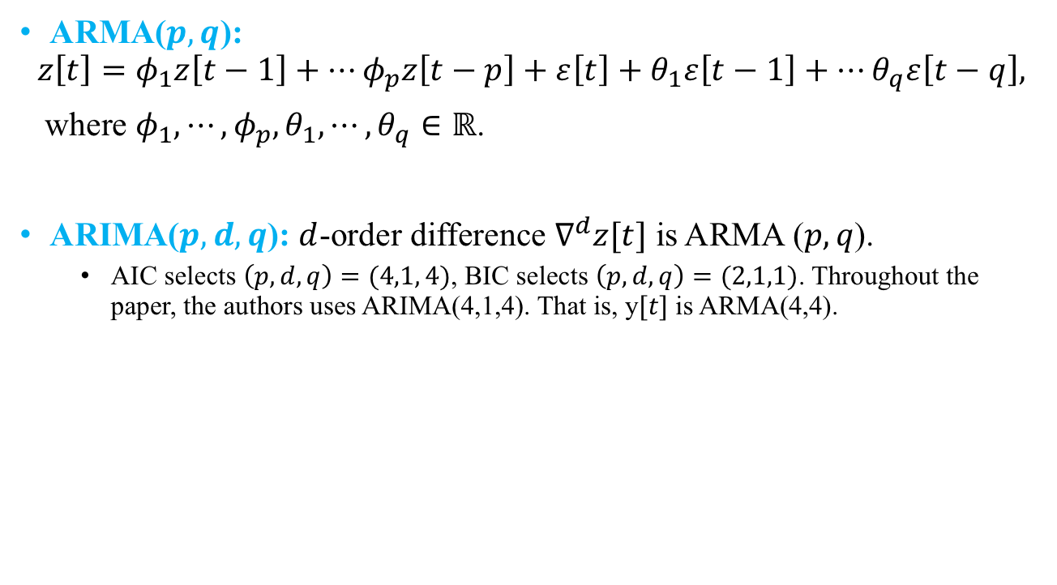
Method 1: ARMA
ARMA($p, q$):
$$z\left[t\right]=φ_{1}z\left[t−1\right]+⋯φ_{p}z\left[t−p\right]+ε\left[t\right]+θ_{1}ε\left[t−1\right]+⋯θ_{q}ε\left[t−q\right],$$
where $φ_{1}, ⋯, φ_{p}, θ_{1},⋯,θ_{q}∈ℝ$.
ARIMA($p,d,q$): $d$-order difference $∇^{d}z[t]$ is ARMA ($p, q$).
AIC selects $\left(p,d,q\right)=(4,1, 4)$, BIC selects $\left(p,d,q\right)=(2,1,1)$. Throughout the paper, the authors uses ARIMA(4,1,4). That is, y$[t]$ is ARMA(4,4).

Slide 9
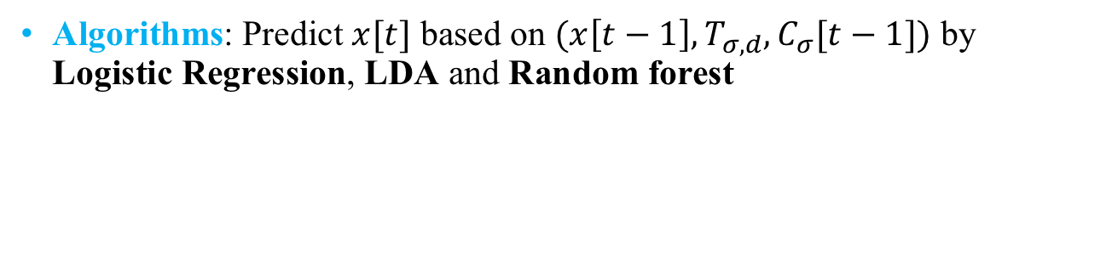
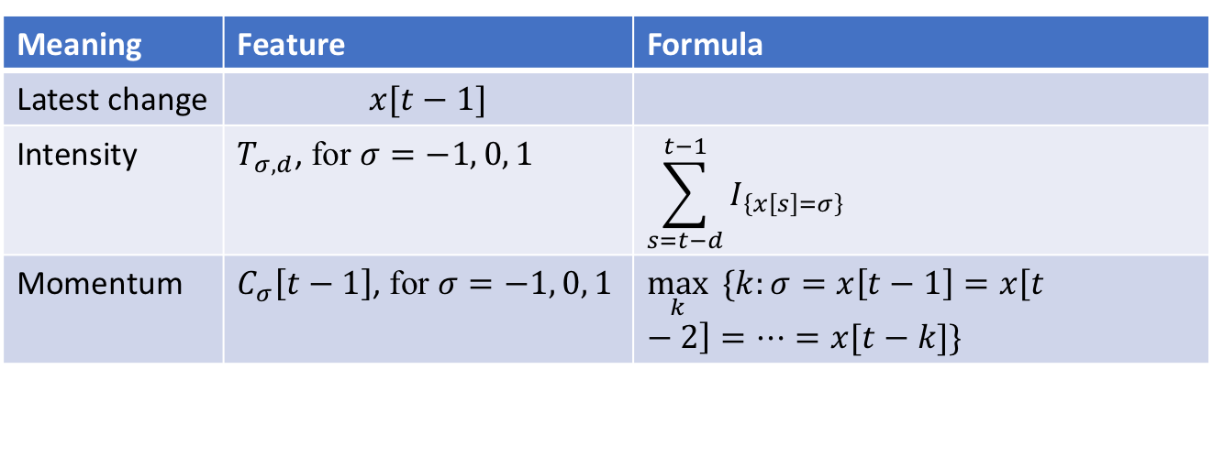
Method 2: Feature Engineering & Classification Algorithms
Meaning | Feature | Formula
Latest change | $$x[t−1]$$
Intensity | $T_{σ,d}$, for $σ=−1, 0, 1$ | $$\sum_{s=t−d}^{t−1}{I_{\left\{x\left[s\right]=σ\right\}}}$$
Momentum | $C_{σ}\left[t−1\right]$, for $σ=−1, 0, 1$ | $$\max_{k}{ \{k:σ=x\left[t−1\right]=x\left[t−2\right]=⋯=x[t−k]\}}$$
Algorithms: Predict $x[t]$ based on $(x\left[t−1\right], T_{σ, d}, C_{σ}[t−1])$ by Logistic Regression, LDA and Random forest

Slide 10
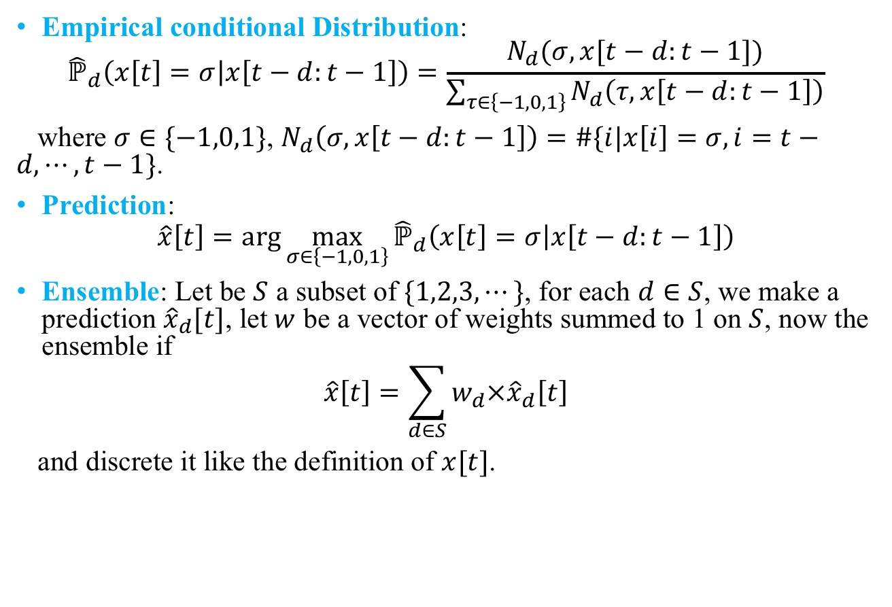
Method3: Prediction by Empirical Conditional Distribution
Empirical conditional Distribution:
$${\hat{ℙ}}_{d}\left(x\left[t\right]=σ | x\left[t−d:t−1\right]\right)=\frac{N_{d}(σ,x[t−d:t−1])}{\sum_{τ∈\left\{−1,0,1\right\}}{N_{d}\left(τ,x\left[t−d:t−1\right]\right)}}$$
where $σ∈\{−1,0,1\}$, $N_{d}\left(σ,x\left[t−d:t−1\right]\right)=\#\{i|x\left[i\right]=σ,i=t−d,⋯,t−1\}$.
Prediction:
$$\hat{x}\left[t\right]=\arg{\max_{σ∈\left\{−1,0,1\right\}}{{\hat{ℙ}}_{d}\left(x\left[t\right]=σ | x\left[t−d:t−1\right]\right)}}$$
Ensemble: Let be $S$ a subset of $\{1,2,3,⋯\}$, for each $d∈S$, we make a prediction ${\hat{x}}_{d}[t]$, let $w$ be a vector of weights summed to 1 on $S$, now the ensemble if
$$\hat{x}\left[t\right]=\sum_{d∈S}{w_{d}×{\hat{x}}_{d}\left[t\right]}$$
and discrete it like the definition of $x[t]$.

Slide 11
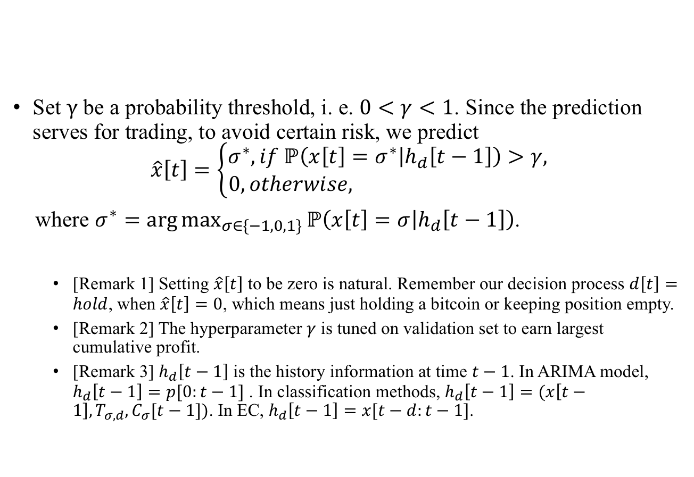
Prediction Ignoring Weak Signal
Set $γ$ be a probability threshold, i. e. $0<γ<1$. Since the prediction serves for trading, to avoid certain risk, we predict
$$\hat{x}\left[t\right]=\left\{\begin{aligned}σ^{∗}, if ℙ\left(x\left[t\right]=σ^{∗} | h_{d}\left[t−1\right]\right)>γ, \\ 0, otherwise, \end{aligned}\right.$$
where $σ^{∗}=\arg{\max_{σ∈\{−1, 0, 1\}}{ℙ\left(x\left[t\right]=σ | h_{d}\left[t−1\right]\right)}}$.
[Remark 1] Setting $\hat{x}\left[t\right]$ to be zero is natural. Remember our decision process $d\left[t\right]=hold$, when $\hat{x}\left[t\right]=0$, which means just holding a bitcoin or keeping position empty.
[Remark 2] The hyperparameter $γ$ is tuned on validation set to earn largest cumulative profit.
[Remark 3] $h_{d}\left[t−1\right]$ is the history information at time $t−1$. In ARIMA model, $h_{d}\left[t−1\right]=p[0:t−1]$ . In classification methods, $h_{d}\left[t−1\right]=(x\left[t−1\right], T_{σ, d}, C_{σ}[t−1])$. In EC, $h_{d}\left[t−1\right]=x[t−d:t−1]$.

Slide 12
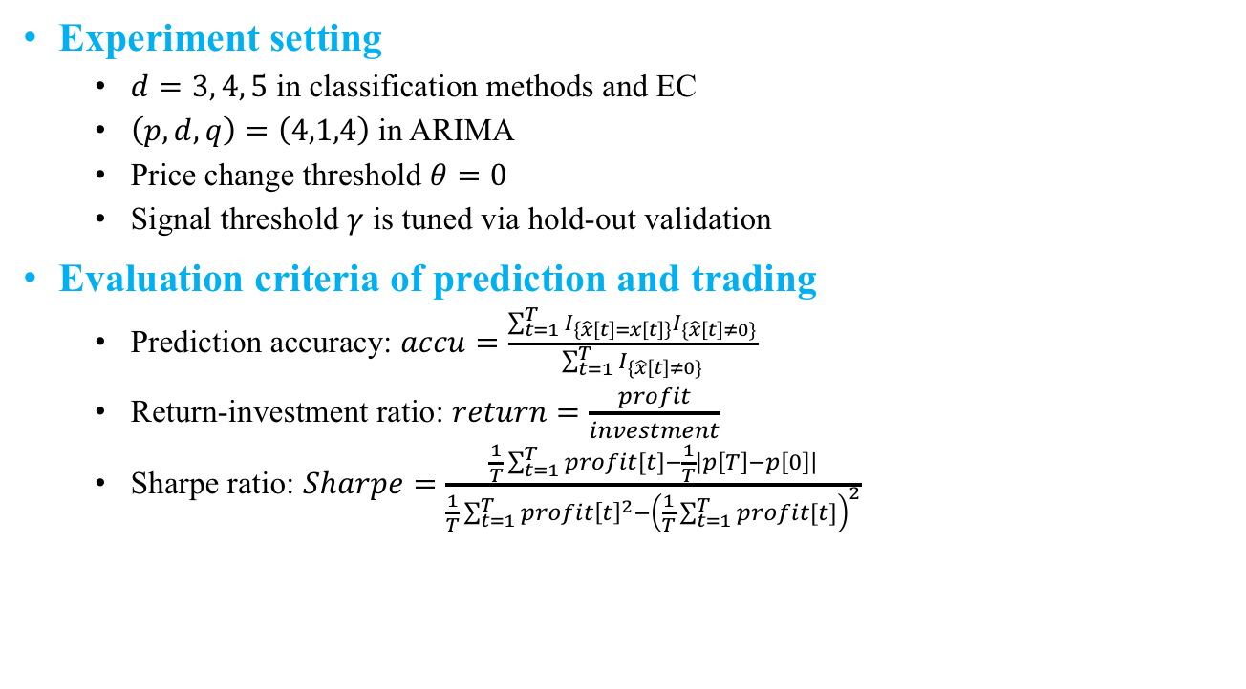
Experiment & Evaluation
Experiment setting
$d=3, 4, 5$ in classification methods and EC
$\left(p,d,q\right)=\left(4,1,4\right)$ in ARIMA
Price change threshold $θ=0$
Signal threshold $γ$ is tuned via hold-out validation
Evaluation criteria of prediction and trading
Prediction accuracy: $accu=\frac{\sum_{t=1}^{T}{I_{\left\{\hat{x}\left[t\right]=x\left[t\right]\right\}}I_{\{\hat{x}\left[t\right]≠0\}}}}{\sum_{t=1}^{T}{I_{\{\hat{x}\left[t\right]≠0\}}}}$
Return-investment ratio: $return=\frac{profit}{investment}$
Sharpe ratio: $Sharpe=\frac{\frac{1}{T}\sum_{t=1}^{T}{profit[t]}−\frac{1}{T}\left|p\left[T\right]−p\left[0\right]\right|}{\frac{1}{T}\sum_{t=1}^{T}{profit{\left[t\right]}^{2}}−{\left(\frac{1}{T}\sum_{t=1}^{T}{profit[t]}\right)}^{2}}$

Slide 13
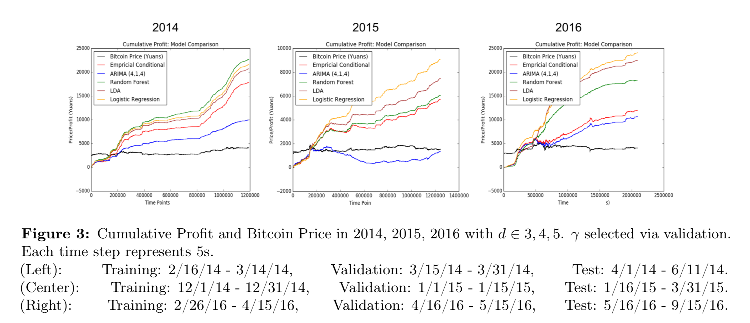
Cumulative profit

Slide 14
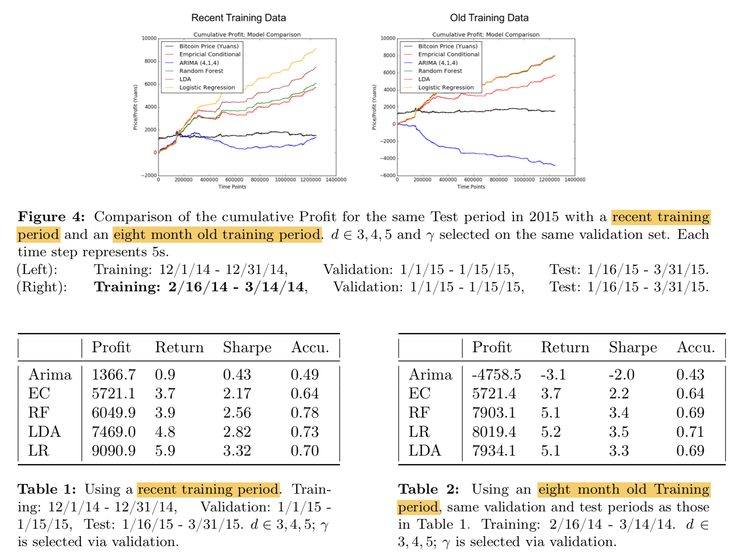
Test of sensitivity to training time periods

Slide 15
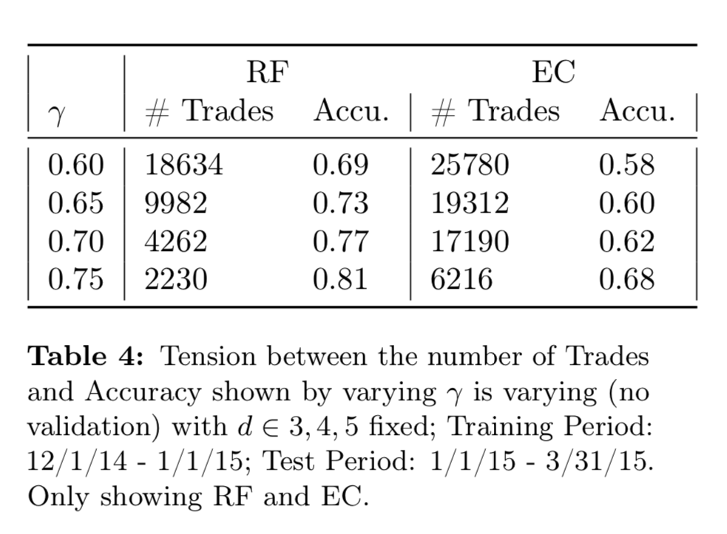
Tension between number of trades and prediction accuracy

Slide 16
Questions?
Trading
Short position?
Permission for high-frequency trading?
Trading fee?
Bull market?
Is simple linear model such logistic regression / LDA really so effective? (It let me recall a word from Andrew: “In financial prediction, you just use linear model!”)

